Slide 1
Pizza Sales Analysis By: Dr Fozia Mehtab

Slide 2
Data Overview
The present analysis used 4 CSV files including orders,order_details,pizzas and pizza_types which was available online.
“order_details” file contain data of order_detail_id, order_id, pizza_id and quantity with 48,620 rows.
“orders” file contain data of order_id, order_date and order_time with 21,350 rows.
“pizza_types” file contain data of pizza_type_id,name,category,ingredients with 32 rows.
“pizzas” file contain data of pizza_type_id,pizza_id,size and price with 96 rows.
13 questions are answered using basic to advanced level SQL queries.
Related files are merged using joins to get the required output for different questions.

Slide 3
Objectives of the Study
To carry out an Exploratory Data Analysis of pizza sales.
To find the the status of orders, sales and revenue on the basis of different criterias using present datasets.

Slide 4
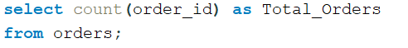
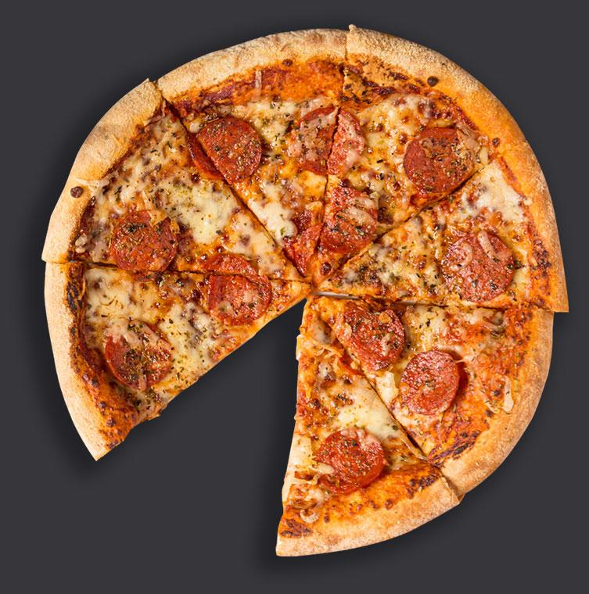
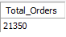

Total Number Of Orders Placed

Slide 5

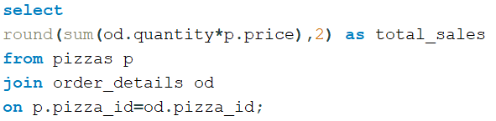
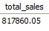
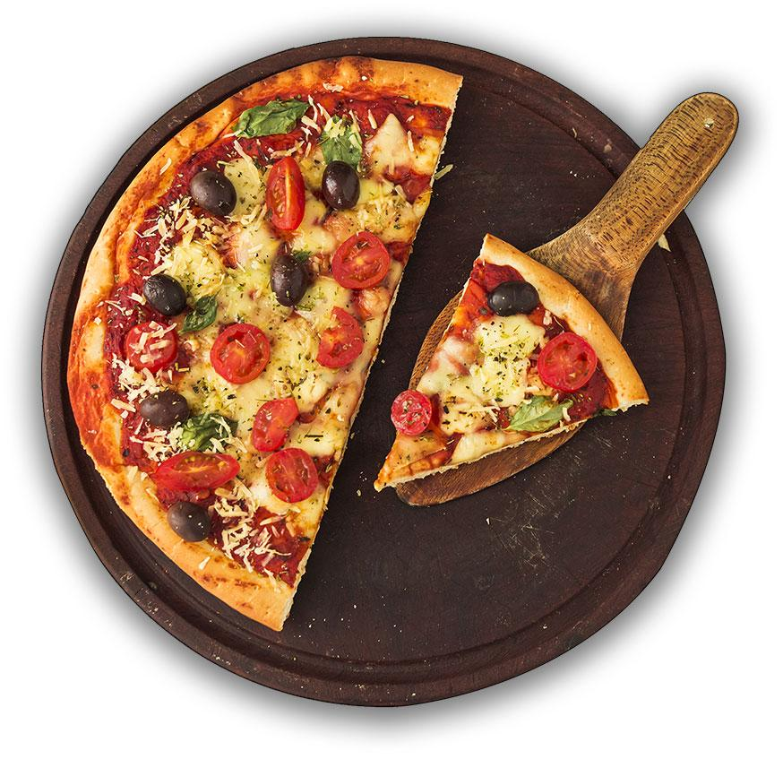


Total Revenue Generated From Pizza Sales

Slide 6
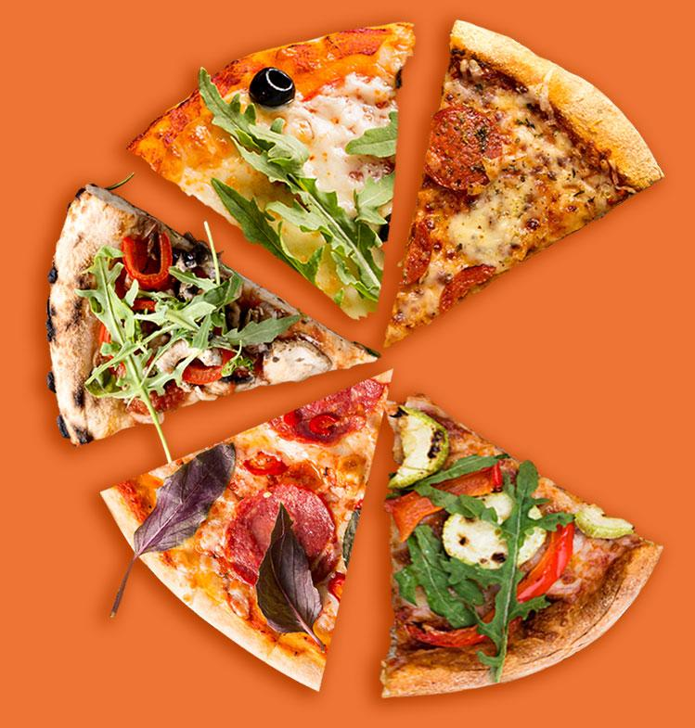
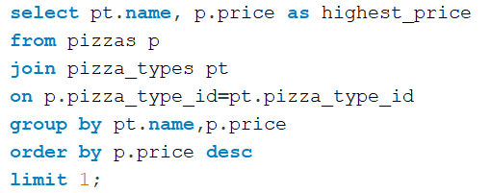


Highest-priced Pizza

Slide 7
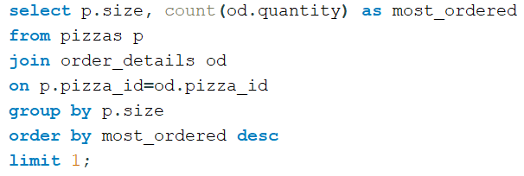
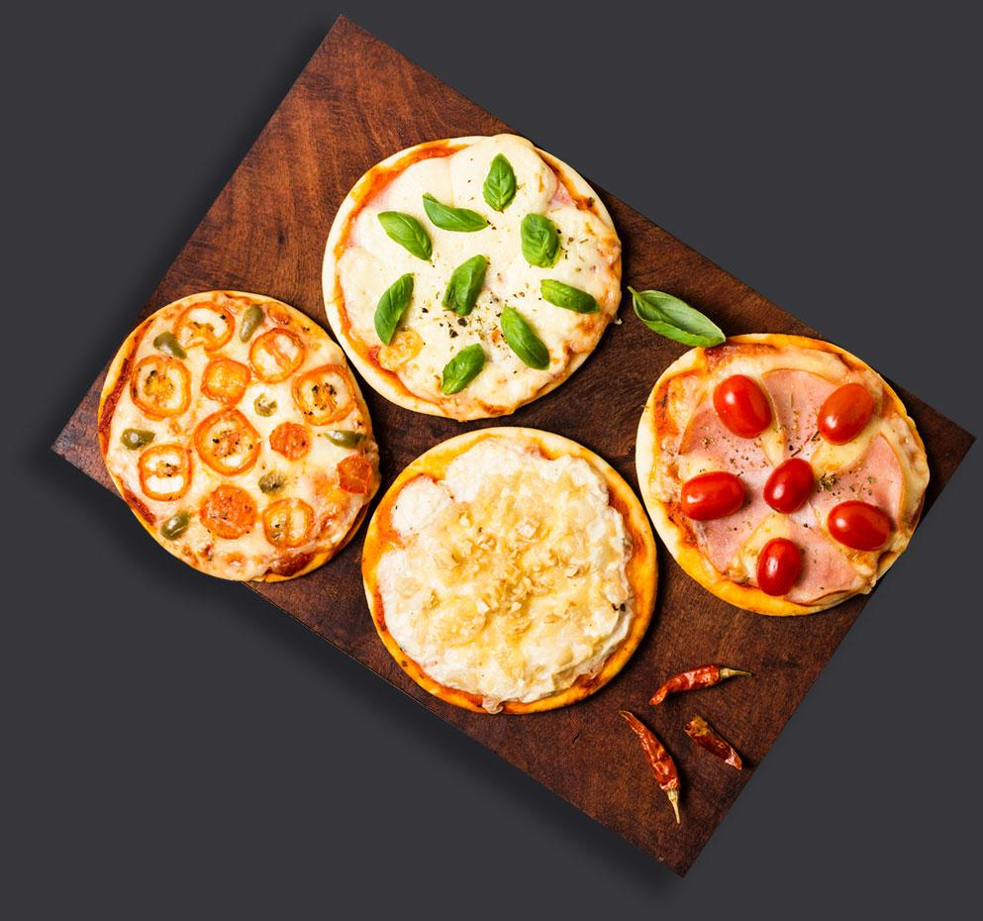
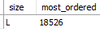
Most Common Pizza Size Ordered

Slide 8
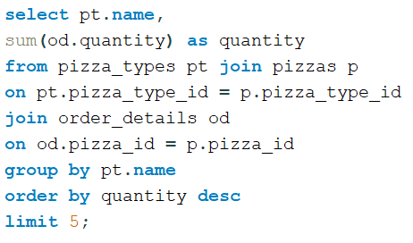
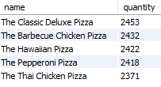
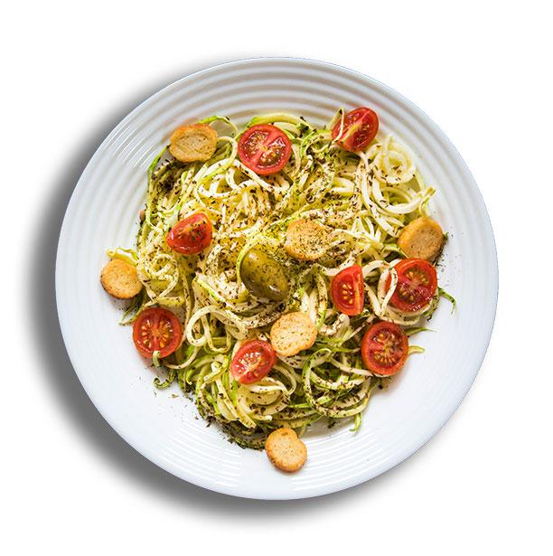
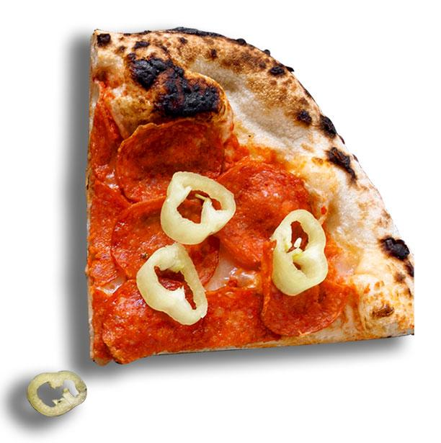
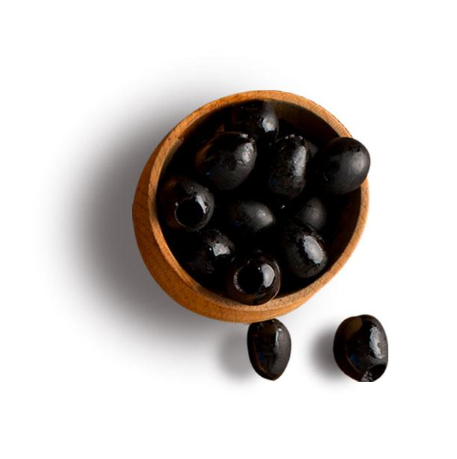
Top 5 Most Ordered Pizza types Along With Their Quantities

Slide 9
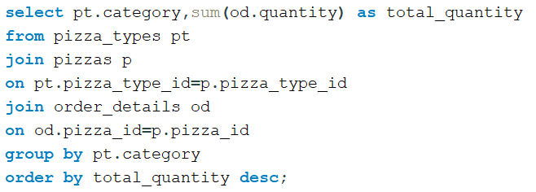
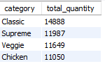
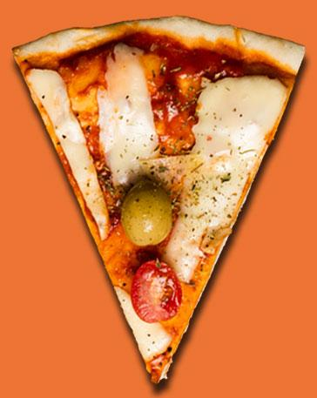
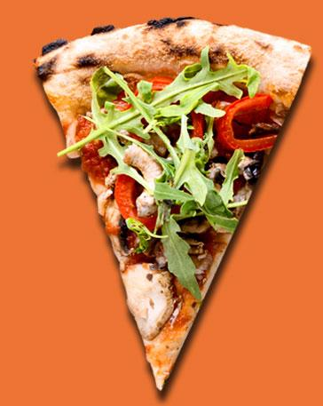
Total Quantity Of Each Pizza Category Ordered

Slide 10
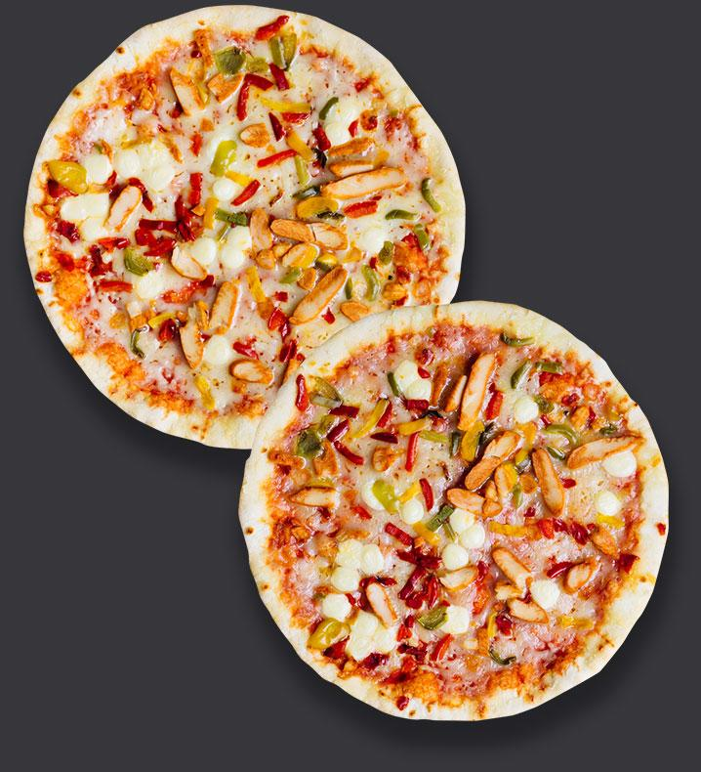
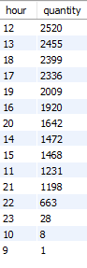
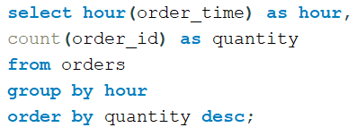
DISTRIBUTION OF ORDERS BY HOUR OF THE DAY

Slide 11
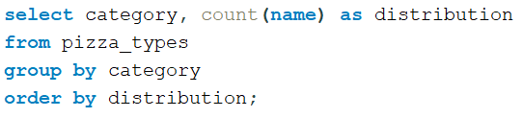


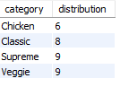

Category-wise Distribution Of Pizzas

Slide 12
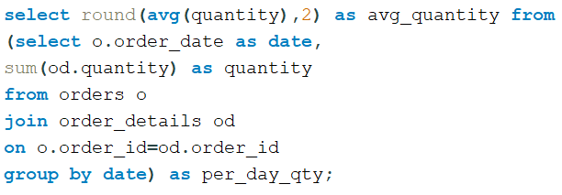
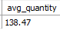
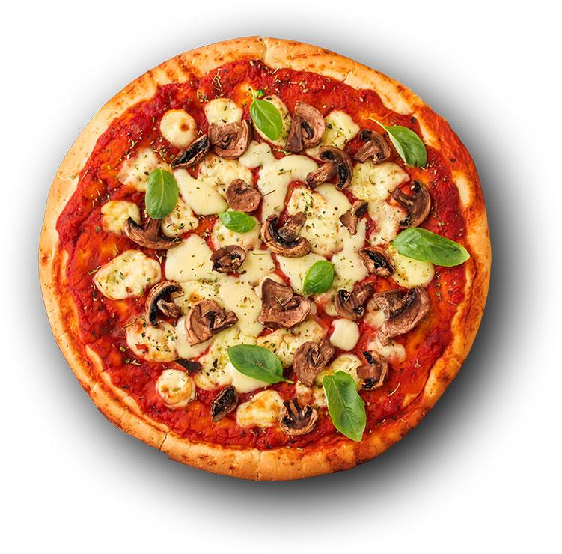
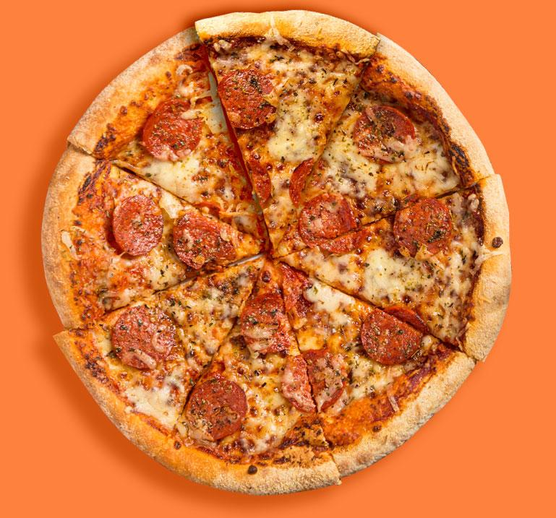
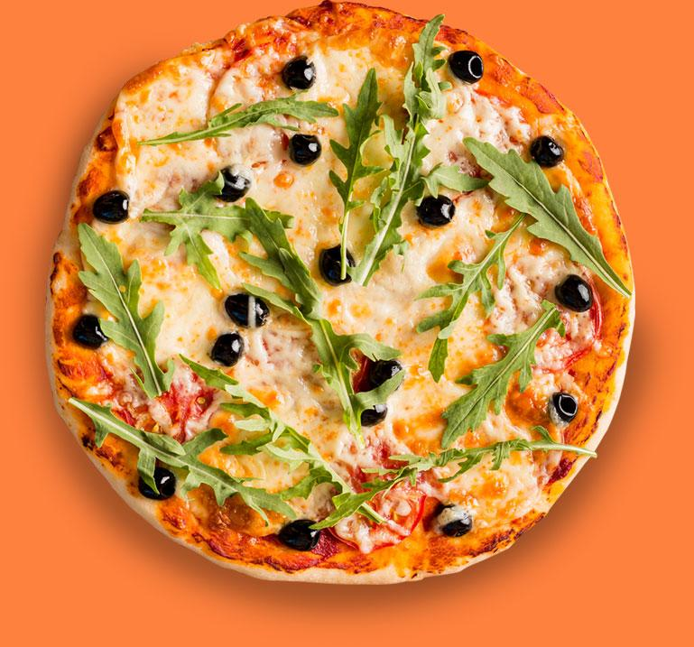
Average Number Of Pizzas Ordered Per Day

Slide 13
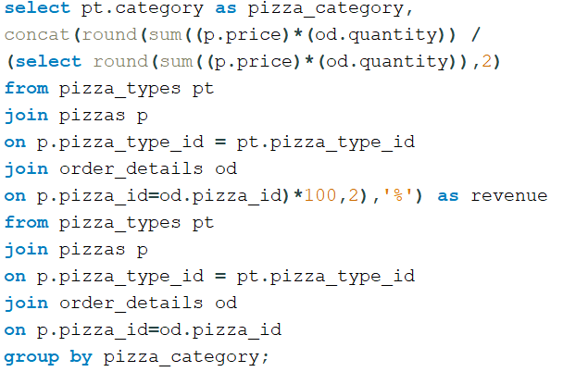
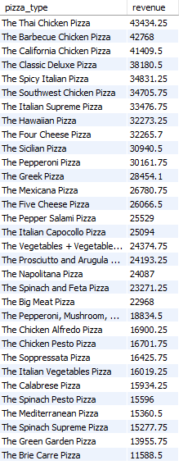
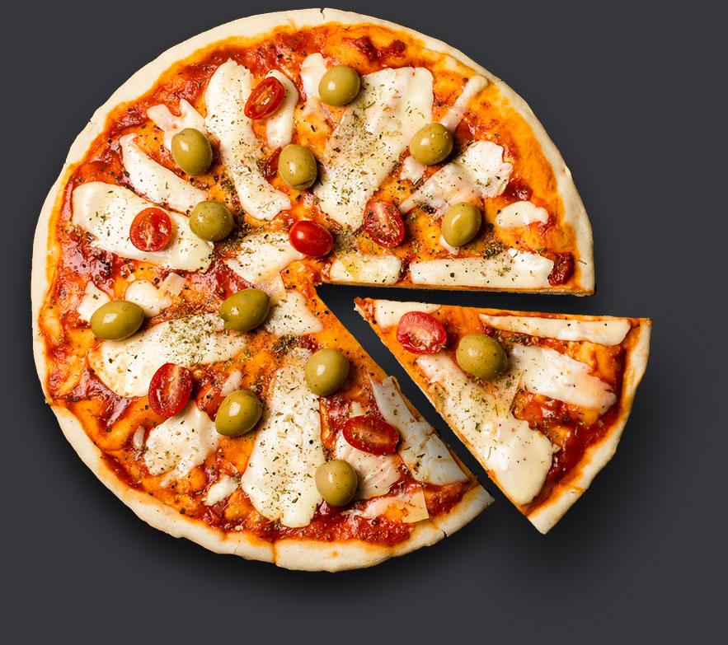
Percentage Contribution Of Each Pizza Type To Total Revenue

Slide 14
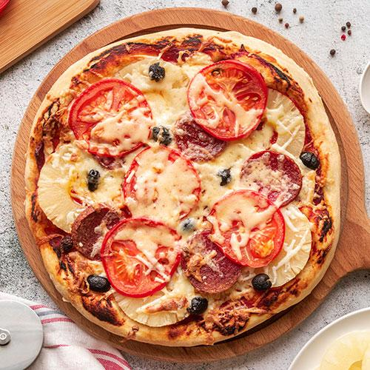
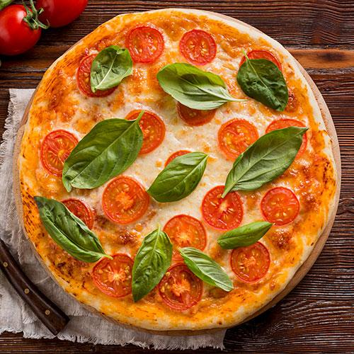
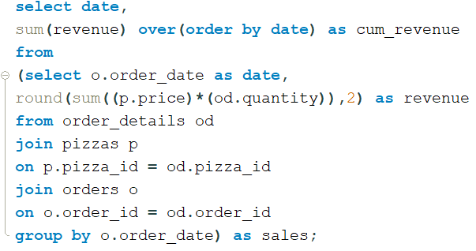
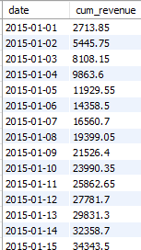
Cumulative Revenue Generated Over Time

Slide 15
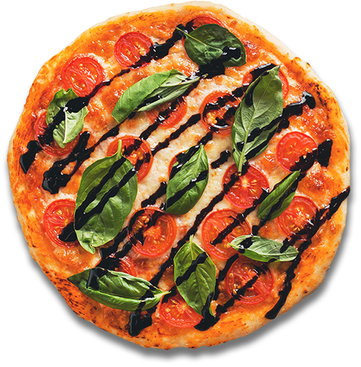
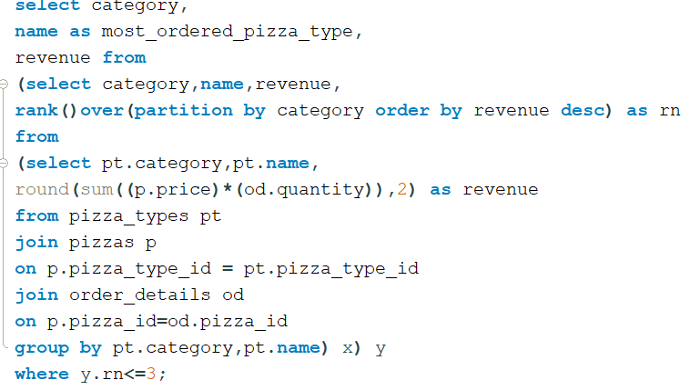
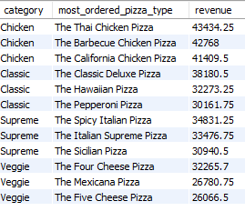
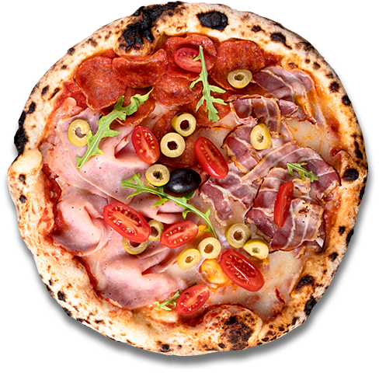
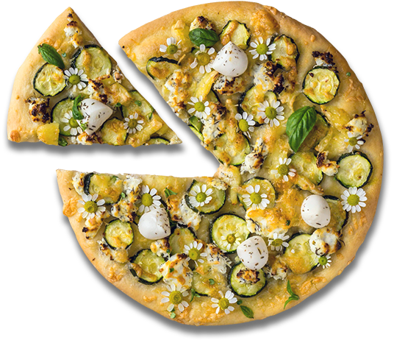
Top 3 Most Ordered Pizza Types Based On Revenue For Each Pizza Category

Slide 16
Summary and Findings
Total order count calculated using order table and it is found 21,350.
Total revenue generated from pizza sales is found to be Rs.8,17,860.
Highest prized pizza is found to be Greek pizza amounting Rs.35.95.
Most commonly ordered size pizza is found to be ‘L’ size with the quanity ordered 18,526.
Top 5 most ordered pizza types are found to be ‘Classic Delux Pizza’ with 2453, ‘Barbeque Chicken pizza’ with 2432,’The Hawaiian pizza’ with 2422, ‘Pepperoni Pizza with 2418, ‘The Thai Chicken Pizza’ with 2371.
The total quantity of each pizza category ordered is found to be Classic 14888, Supreme 11987, Veggie 11649, Chicken 111050.
In the distribution of orders by hour of the day the peak hour with highest number of orders is found to be 12 o’ clock with 2520 quanity and minimum orders with only 1 is found at 9 o’ clock.
In category wise distribution of pizza veggie pizza has got the maximum with 9 and chicken pizza got the minimum with 6.
The avg number of pizzas ordered per day is found to be approximately 138.
In the percentage contribution in revenue ‘Thai Chicken Pizza’ has contributed the most with Rs.43434 followed by ‘Barbeque Chicken Pizza and ‘Brie Crre Pizza’ has contributed the least with Rs.11,588.
There is found to be a constant rise in the cumulative revenue over time and it is found to be Rs.8,17860 at the end of the month.
In top 3 most ordered pizza types based on revenue is found to be Chicken categories is found to be on top, followed by classic and veggie categories was found at the bottom.

Slide 17
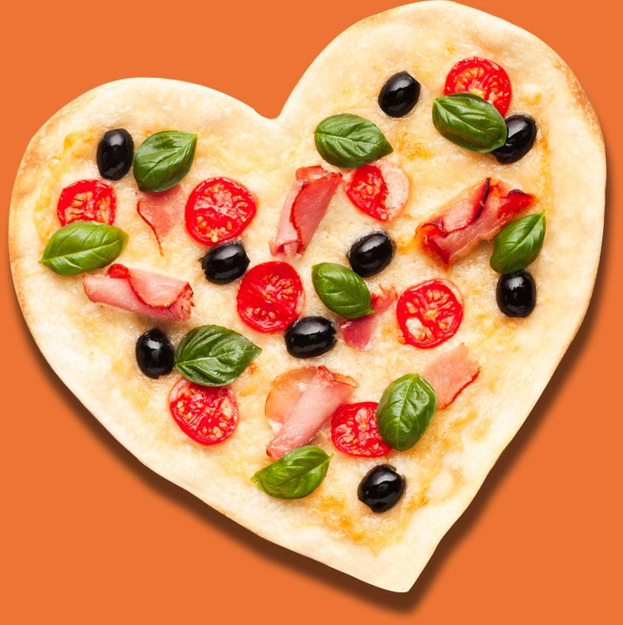
Thank-you for your Time

